Slide 1

Optimizing Self-Management in Type 2 Diabetes: The Role of High Intensity Interval Training in Enhancing Health Outcomes
Jonas Munk Jensen, Ba. Physiotherapy, Msc, Health Science. PhD-student
Annelli Sandbæk, Clinical professor in General Medicine, Department of Public Health, Aarhus University
Anette Andersen, MD, PhD, Steno Diabetes Center Aarhus, Aarhus University Hospital
Søren T. Skou, PT, MSc, Professor, Sports Science and Clinical Biomechanics, University of Southern Denmark and The Research and Implementation Unit PROgrez, Slagelse Hospital
Sara Marie Hebsgaard Offersen, PhD in Anthropology, Steno Diabetes Center Aarhus, Aarhus University Hospital
Notes:
Lifestyle interventions are central to managing Type 2 diabetes. In Denmark, diabetes self management programmes have traditionally been delivered by municipalities, but this is about to change. With the healthcare reform planned for next year, the responsibility will move to the regions, creating pressure for more standardised programmes, particularly regarding exercise.
The challenge is that we still lack basic knowledge in three key areas. First, the evidence for how exercise should be delivered as part of these programmes is still limited. Second, even when exercise is offered, it remains difficult to get people to choose it and to stick with it over time. And third, we do not have a clear picture of who actually uses these services, and who does not
My PhD will address these questions.

Slide 2
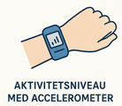
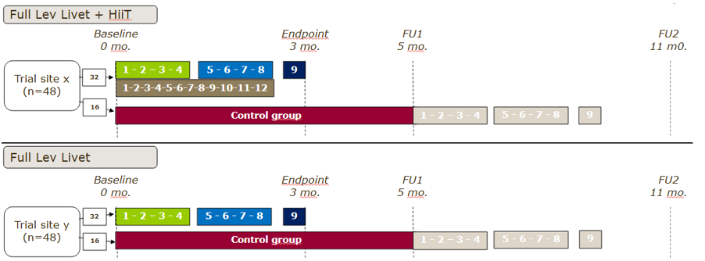
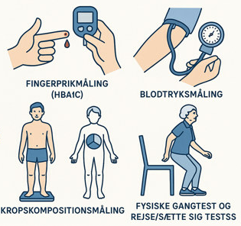
Effectiveness – Pragmatic RCT
Primary outcome
Secondary outcomes
Notes:
The first study is a RCT in which I compare a diabetes self management programme, Lev Livet, with Lev Livet plus supervised high intensity interval training and a control group. The main outcome is objectively measured physical activity, with secondary outcomes including cardiometabolic risk markers and functional capacity. This study examines the added value of structured HIIT beyond education alone.

Slide 3
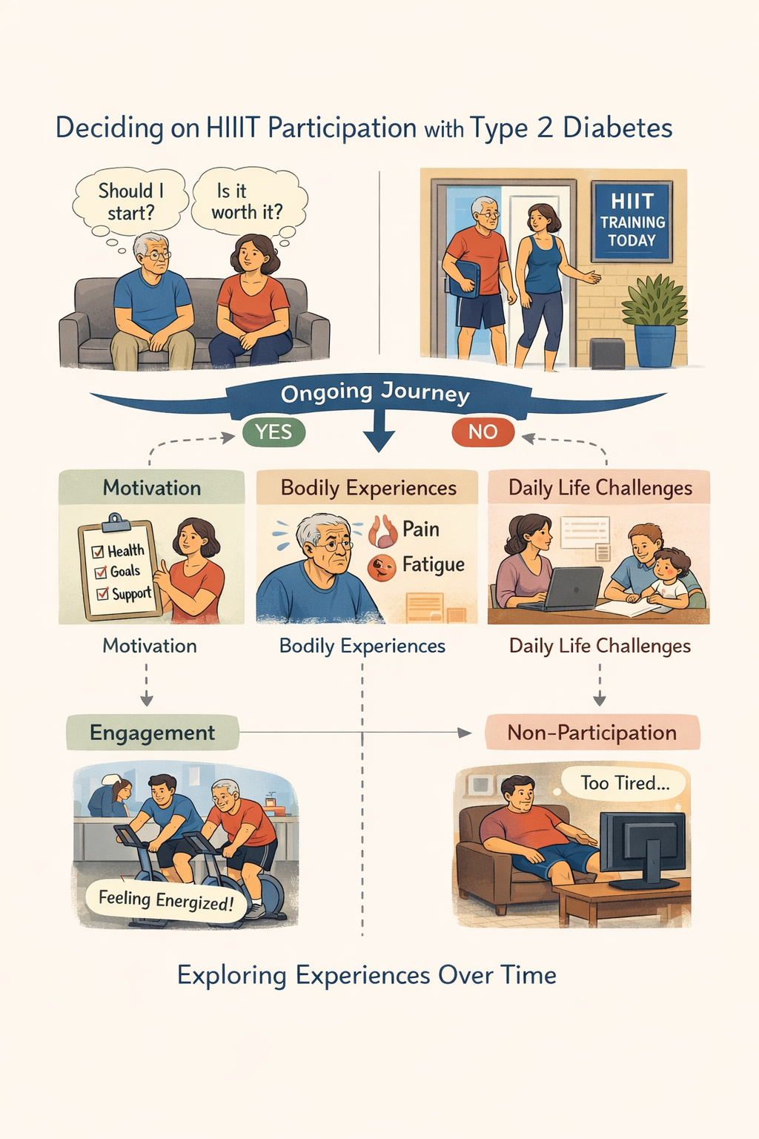
To HiiT or Not To HiiT A qualitative study
Notes:
The second study is qualitative and follows people with Type 2 diabetes as they decide, over time, whether or not to participate in HIIT as part of a diabetes self management programme and show up to the individual training sessions. By viewing participation as an ongoing process rather than a single choice, the study explores how motivation, bodily experiences, and everyday life influence engagement and non participation. Participants are followed for more than a year.

Slide 4
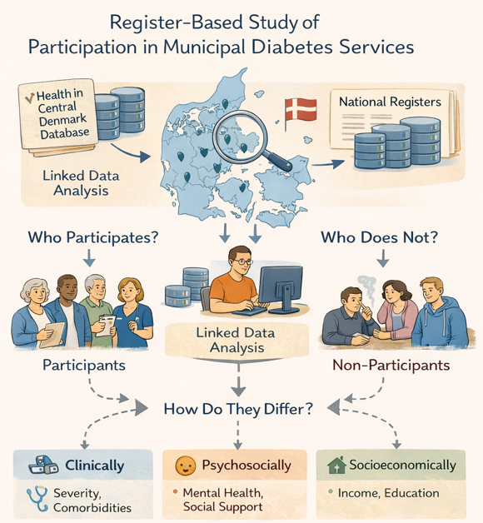
A register based study investigating reach
Notes:
The third study is a register based study using data from Health in Central Denmark linked with national registers. It examines who participates in municipal diabetes services, who does not, and how these groups differ clinically, psychosocially, and socioeconomically.
Together, the PhD will provide evidence to support the redesign of exercise based diabetes programmes at a time when the healthcare system is under change.

